Slide 1
AE-Morpher: Improve Physical Robustness of
Adversarial Objects against LiDAR-based
Detectors via Object Reconstruction
G13
Hui Jin
Jiarui Zhu
Harshitha Bashyam
Apr 21, 2025

Slide 2
Background & Research Motivation

Slide 3
Why Autonomous Driving Needs LiDAR?
🚗 More cars are driving themselves — safety matters.
🌐 LiDAR helps them "see" the world in 3D.

Slide 4
Challenges of Existing Physical Adversarial Attacks
🧱 Hard to deceive LiDAR in the real world → Digital adversarial objects don’t always work when physically built.
⚡ Gap between digital design & LiDAR capture → Sparse beams miss critical perturbations on irregular surfaces.

Slide 5
Problem Analysis & Motivation

Slide 6
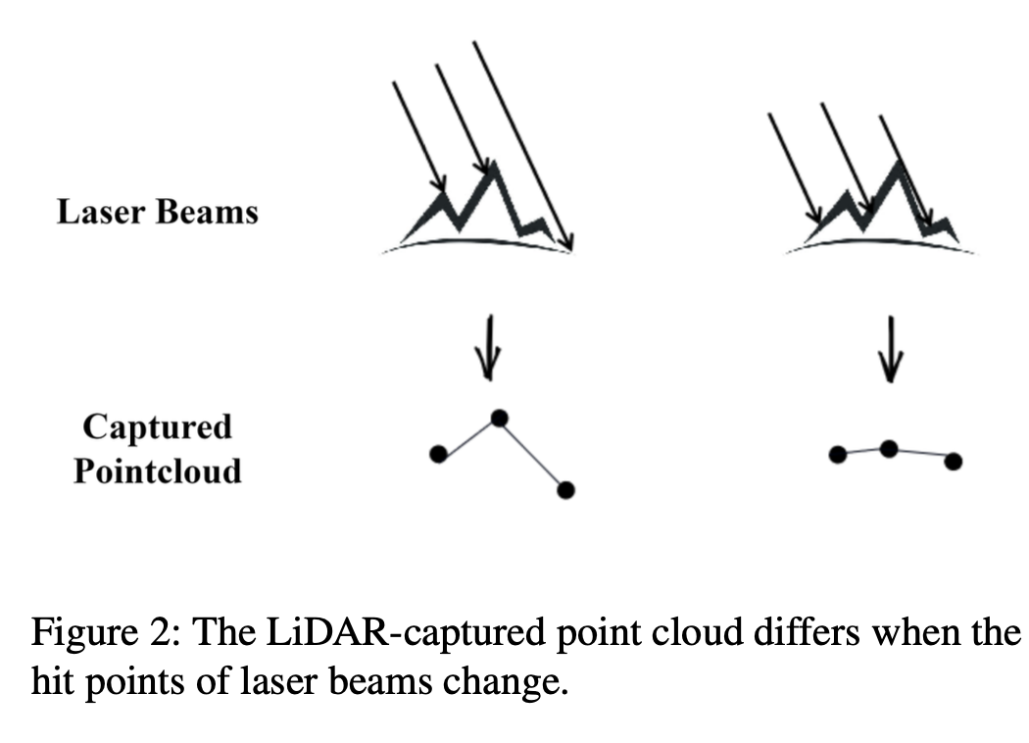
Why Physical Attacks on LiDAR are Difficult
LiDAR attacks are hard because real-world scans often differ from digital designs.
Sparse laser beams can’t accurately capture scattered perturbations, especially on irregular or sharp surfaces.

Slide 7
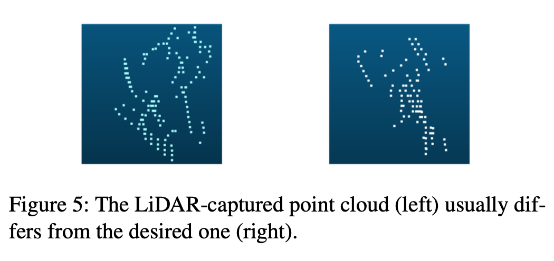
Why Physical Attacks on LiDAR are Difficult
LiDAR often fails to capture ideal adversarial point clouds.
Irregular surfaces and sparse laser beams cause errors and miss key perturbations, reducing attack effectiveness.

Slide 8
System framework & innovations

Slide 9
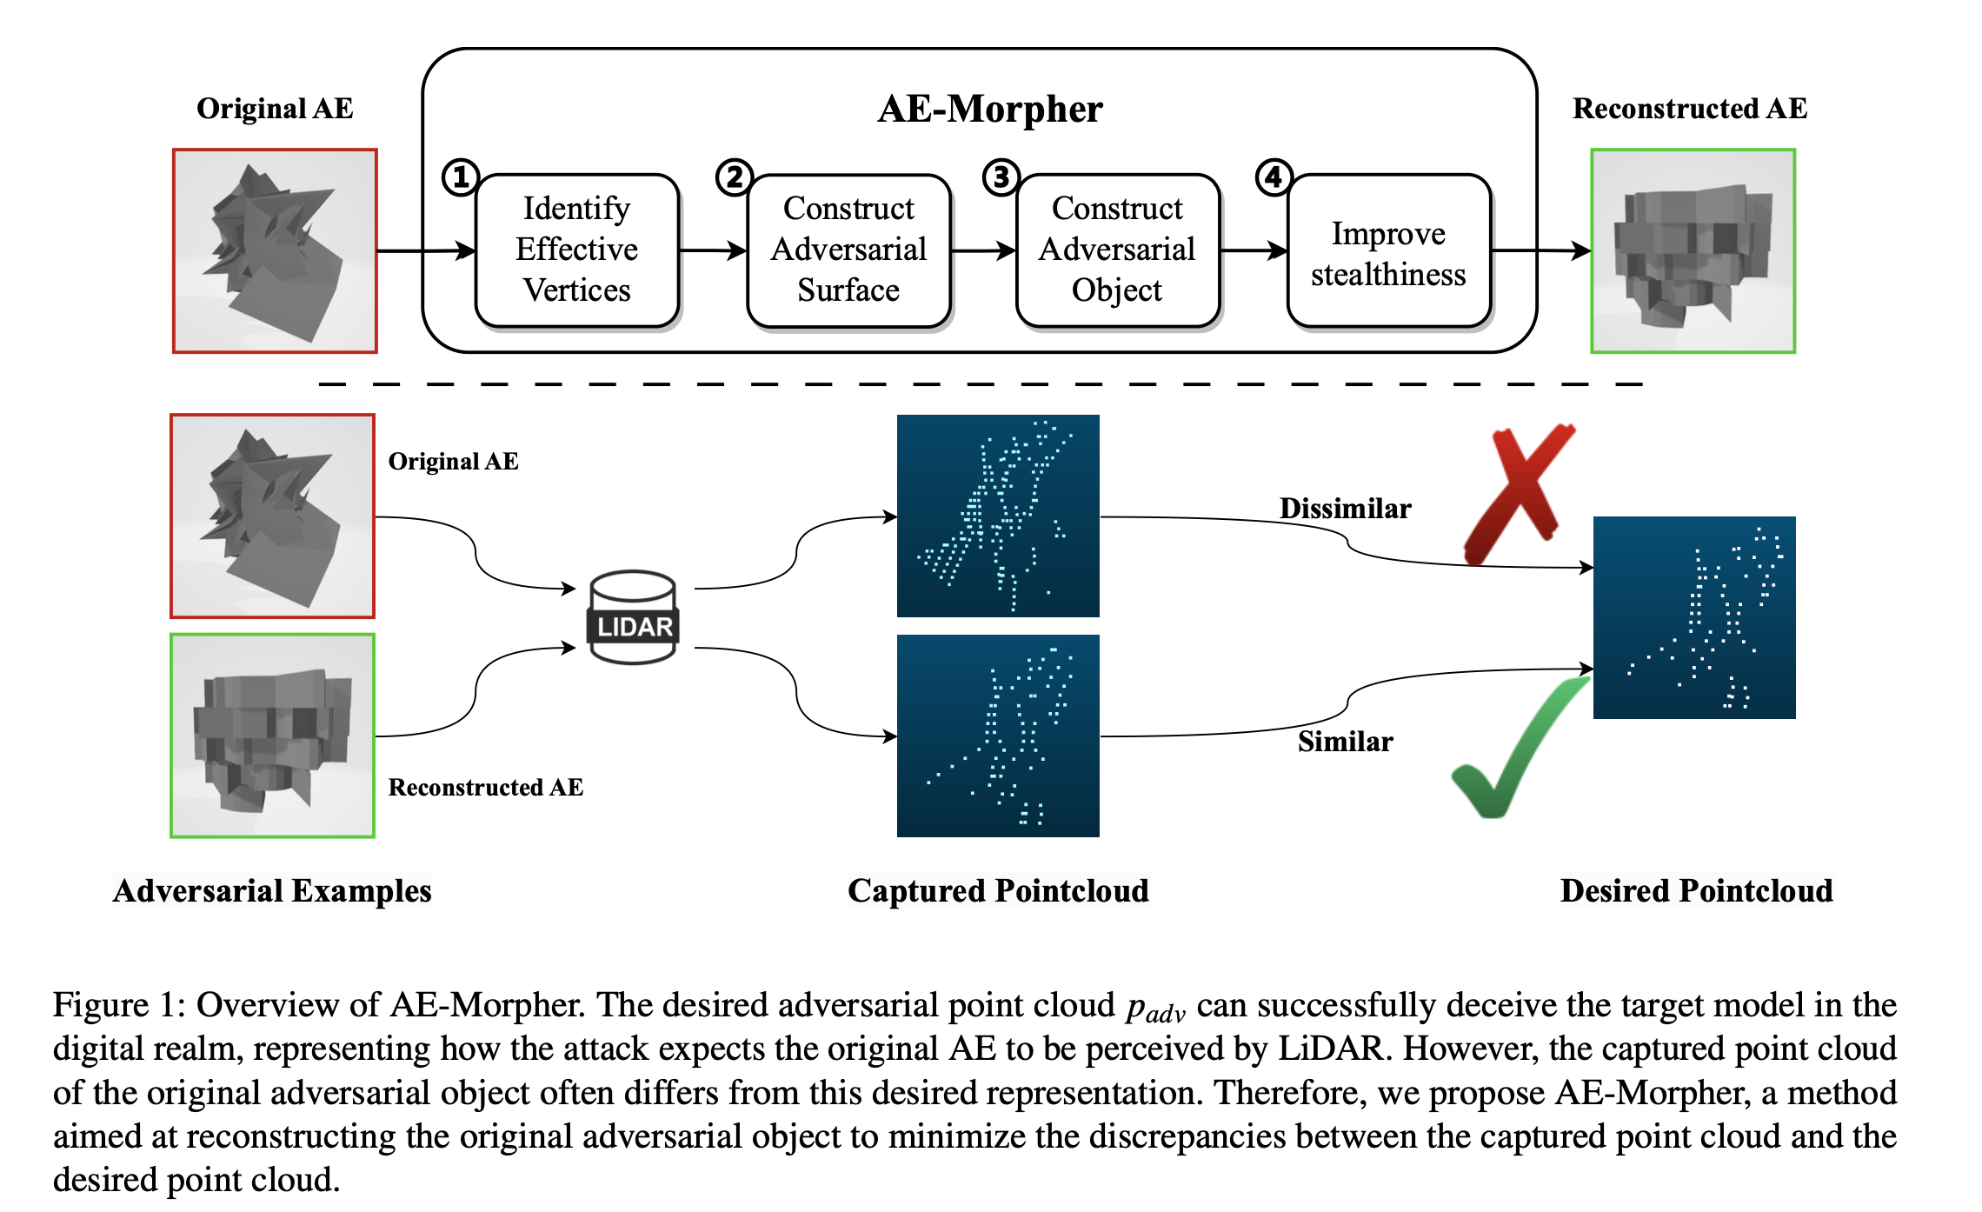
System Overall Design
Extracting effective adversarial vertices:
Identify effective vertices that truly fool LiDAR. This reduces redundancy and helps build smaller, more stealthy adversarial objects.

Slide 10
System Overall Design
Constructing adversarial surfaces:
Build flat surfaces around key vertices to reduce LiDAR scanning errors and improve physical-world robustness.

Slide 11
System Overall Design
Constructing the adversarial object:
Connect flat surfaces into a continuous 3D shape to ensure structure and improve LiDAR capture in the real world.

Slide 12
System Overall Design
Improved stealth:
Adjust size and shape to balance stealth and robustness for real-world practicality.

Slide 13
AE-Morpher Technical Details

Slide 14
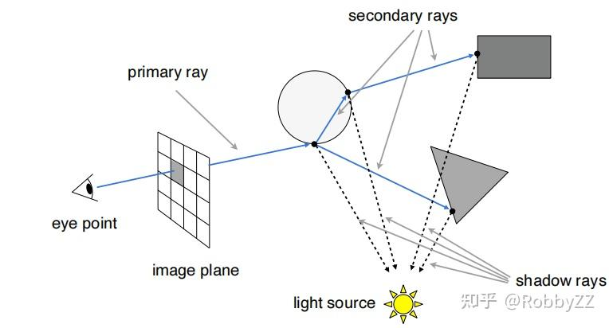
Valid Vertex Identification
Ray-casting simulates LiDAR scans to find effective vertices.
Only vertices that fool the model are kept — reducing redundancy and improving stealth.

Slide 15
Counter Surfaces and Counter Objects
Planar surfaces are added around key vertices to reduce laser deviation and improve LiDAR capture accuracy.
This boosts attack success while keeping the object stealthy.

Slide 16
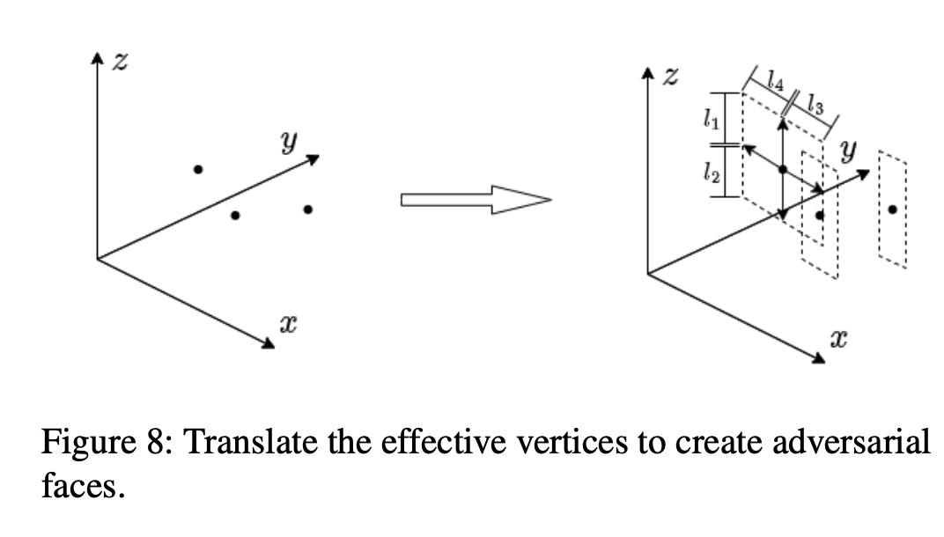
Adversarial Object Construction
Connect adversarial surfaces into a continuous 3D shape to ensure structure and improve LiDAR capture.

Slide 17
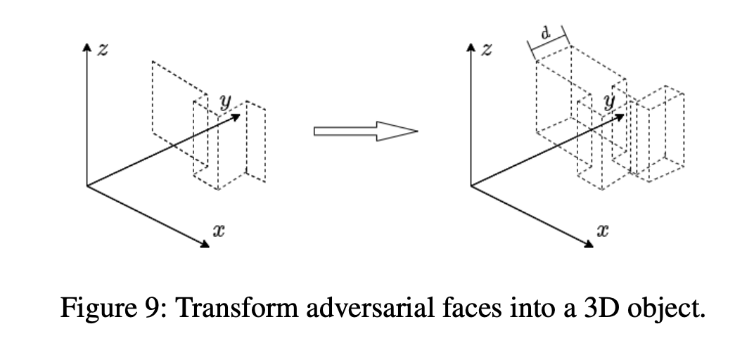
Concealment Adjustment
Adjust size and shape to balance stealth and robustness for real-world use.

Slide 18
Experimental Design & Results Analysis

Slide 19
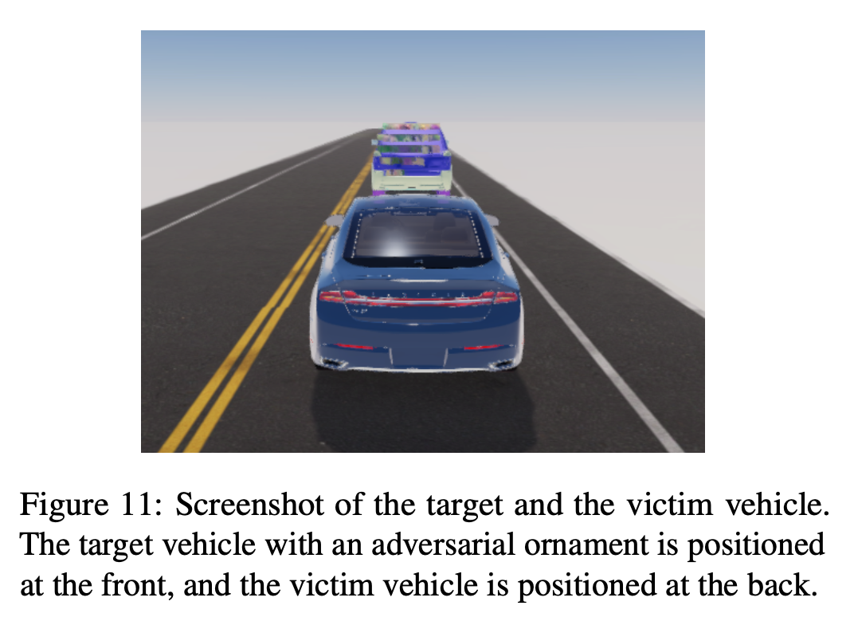
SVL Simulator + Apollo
Experiments used SVL Simulator and Apollo to test static and dynamic attacks in realistic driving environments.

Slide 20
Dynamic Attack Performance Improvement Comparison
AE-Morpher boosts attack success by 38.64% and reduces projection area by 67.59%, showing strong performance in dynamic attacks.
Method | Attack success rate | Reduced projection area
Original | 100% | -
AE-Morpher | 71.4% | 67.59%

Slide 21
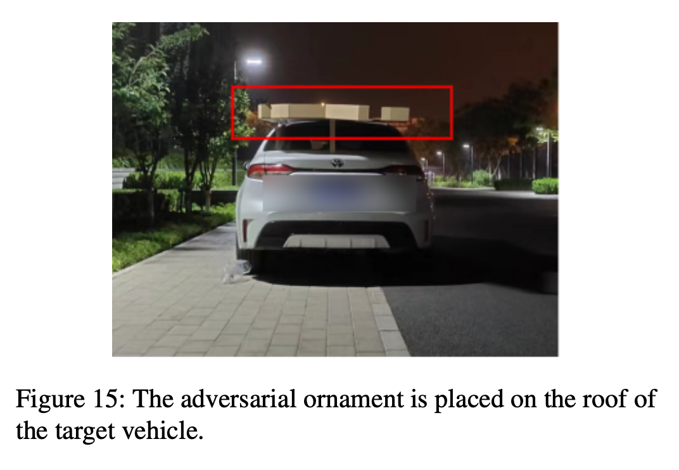
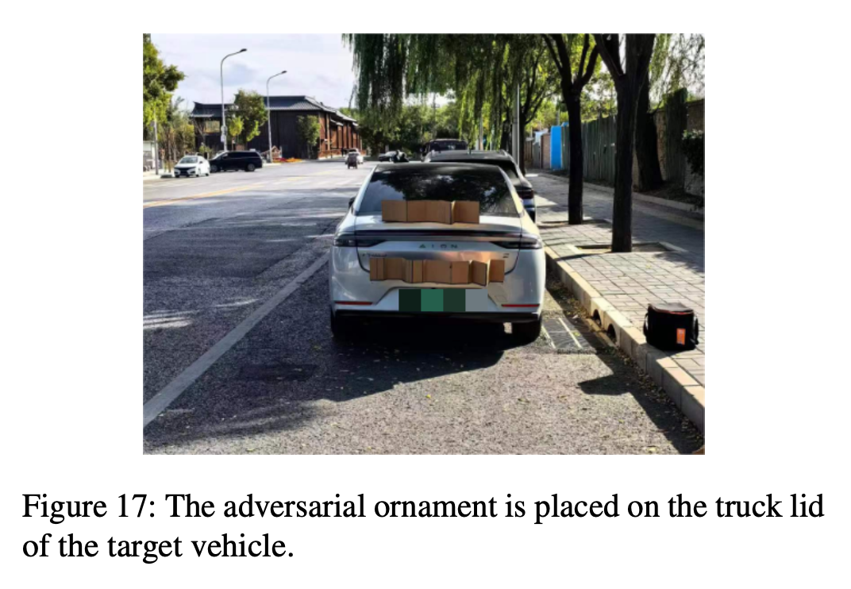
Real Environment Experiment
Real-world tests with RS-LiDAR-16
Daytime success rate: 80.8%
Nighttime success rate: 71.4%

Slide 22
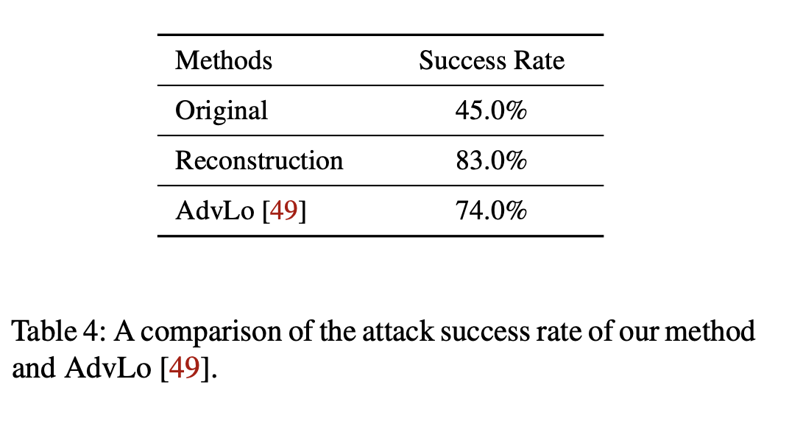
Comparison Results with AdvLo
AE-Morpher outperforms AdvLo by 9% showing clear advantages in both attack success and stealth (smaller projection area).

Slide 23
Fusion Attack Effect

Slide 24
Fusion Attack (LiDAR+Camera)
Fusion attack targets both LiDAR and camera using shape + texture to deceive both models.
At 20m, success rate reached 75.6%.

Slide 25
Advantages & Innovation

Slide 26
Advantages & Innovation
AE-Morpher reveals how sparse LiDAR affects adversarial attacks and uses geometry reconstruction to boost robustness.
It works without expensive 3D printing — practical and feasible.

Slide 27
Restriction Analysis

Slide 28
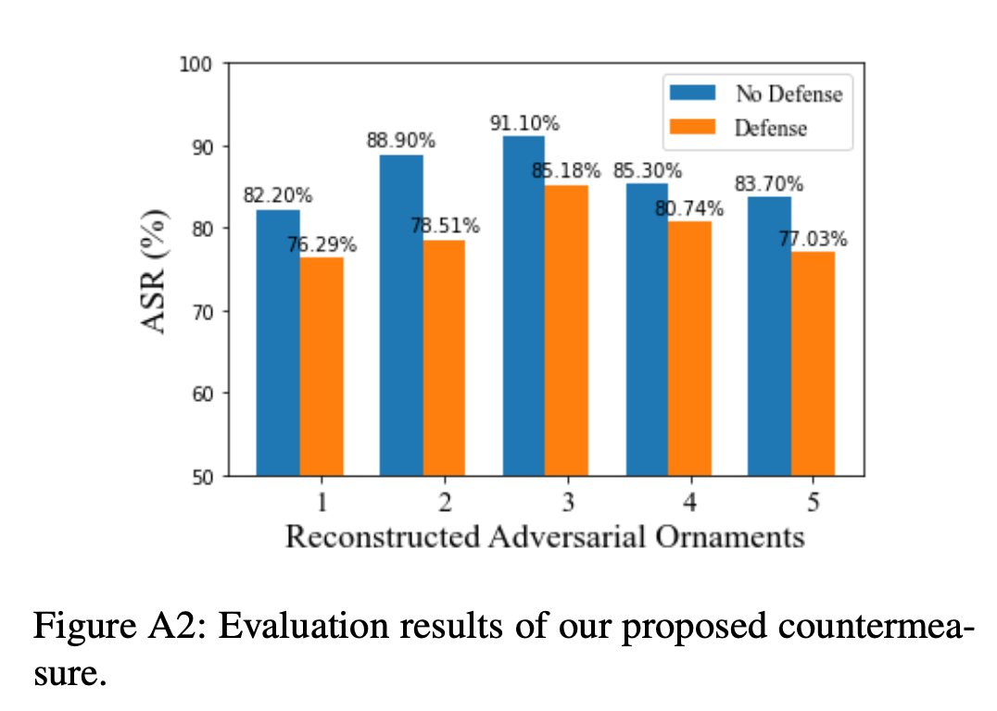
limitation
Designed for a single LiDAR — may struggle with multi-LiDAR setups
Real-world dynamics (e.g. traffic, pedestrians) may reduce effectiveness
LiDAR resolution differences can impact performance

Slide 29
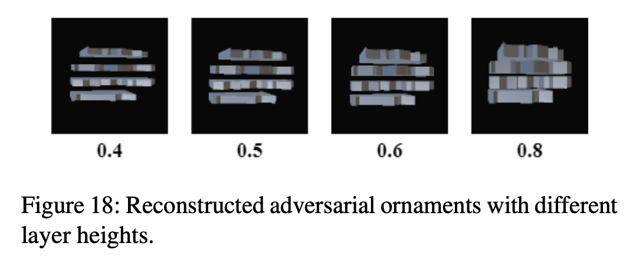
Future Work
Adapt to multi-LiDAR systems for consistent point cloud capture
Improve robustness in dynamic environments with real-time adjustments
Optimize for LiDARs with different resolutions to enhance generalization

Slide 30
Reflection

Slide 31
Advantages and Disadvantages
Unlike prior work focused on point cloud optimization, AE-Morpher addresses info loss during LiDAR capture.
It achieves 71.4% (night) / 80.8% (day) success in real-world tests (16-line LiDAR vs. 64-line in simulation).
However, it still relies on adding visible adversarial ornaments to the target vehicle.

Slide 32
Continuing Research
Current method targets specific LiDAR types.
Adapting to different LiDAR technologies (e.g., solid-state, MEMS) could improve versatility.
It also performs best in static or short-range settings — effectiveness may drop in complex or high-speed scenarios.

Slide 33
Thanks for watching!
Any Questions?
G13
Hui Jin
Jiarui Zhu
Harshitha Bashyam
Apr 21, 2025
AE-Morpher: Improve Physical Robustness of
Adversarial Objects against LiDAR-based
Detectors via Object Reconstruction

